Slide 1
Show and Tell: Super-Minipwner
James Edge
Attack & Penetration Testing Practice Manager

Slide 2


Show and Tell

Slide 3
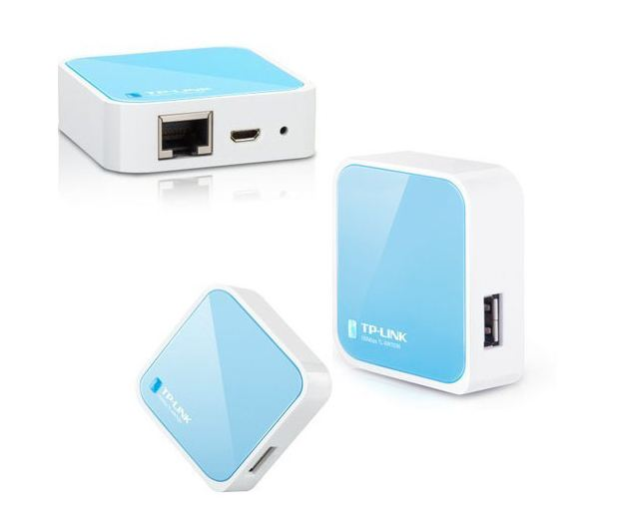
TP-Link WR703N

Slide 4
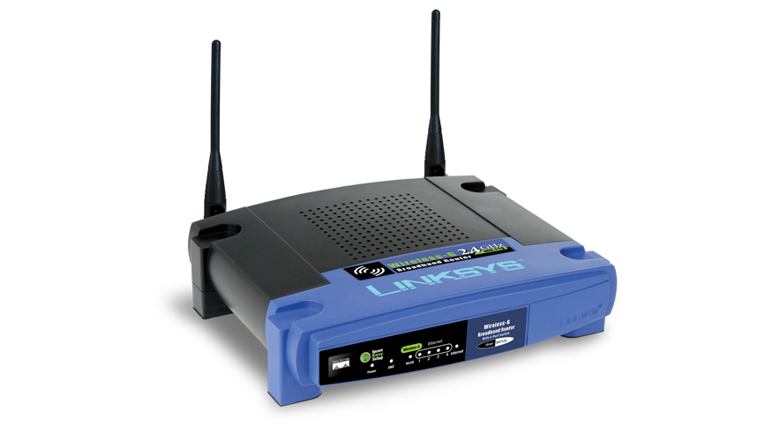
Linksys WRT54GL

Slide 5
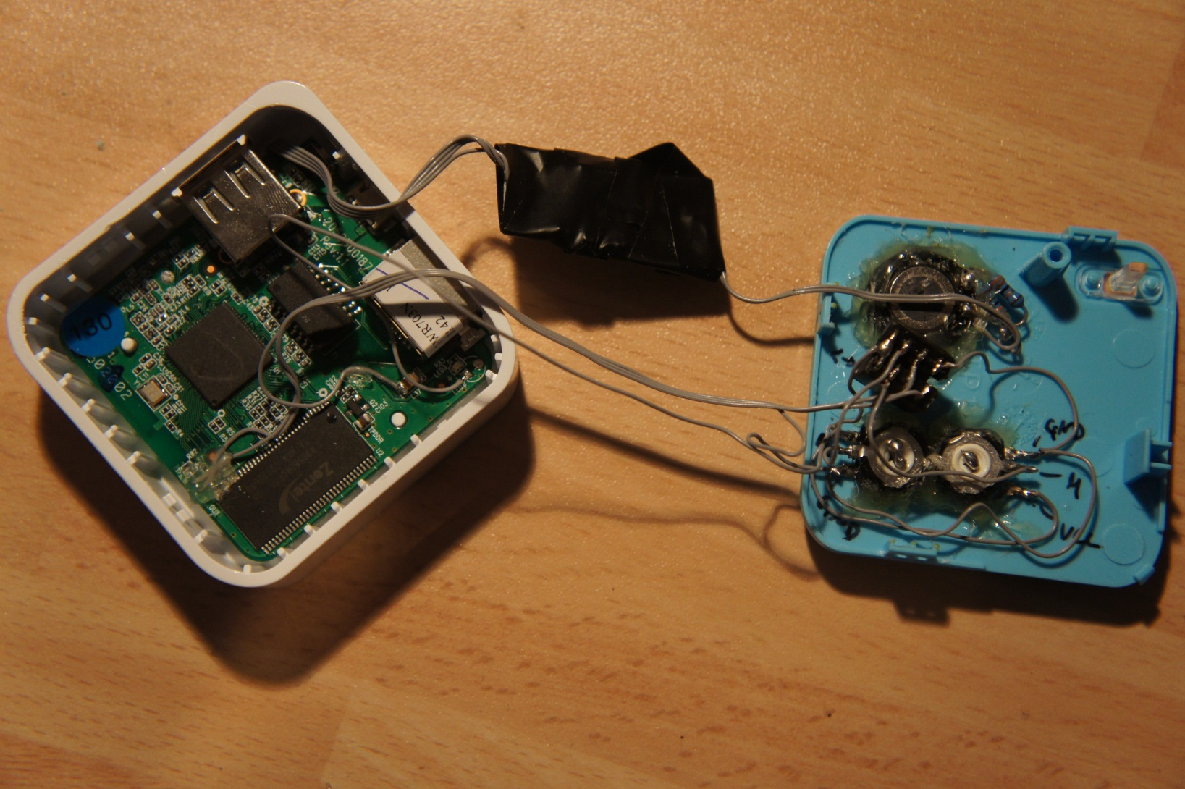
Web Radio

Slide 6
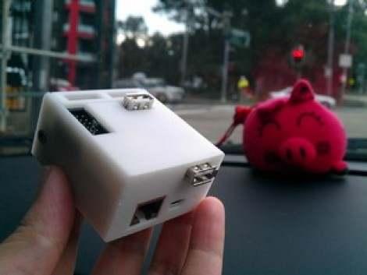
I/O Extender w/ 3D Printed Case

Slide 7
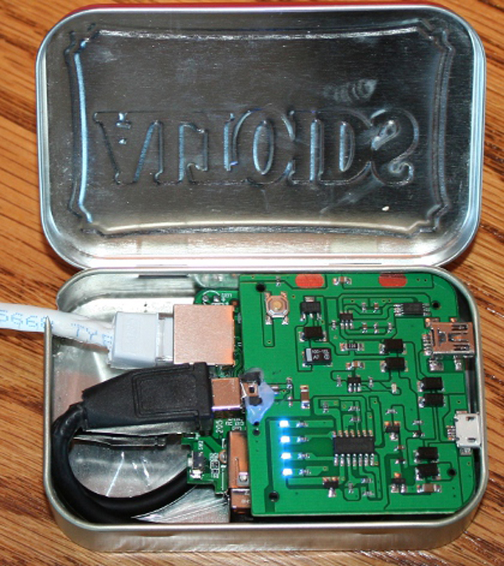
Minipwner in Altoids Tin

Slide 8
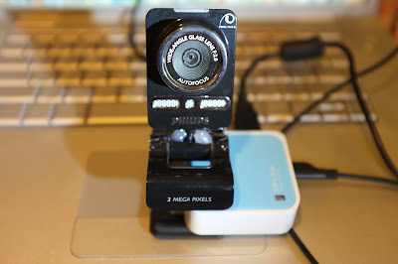
Web Cam Server

Slide 9
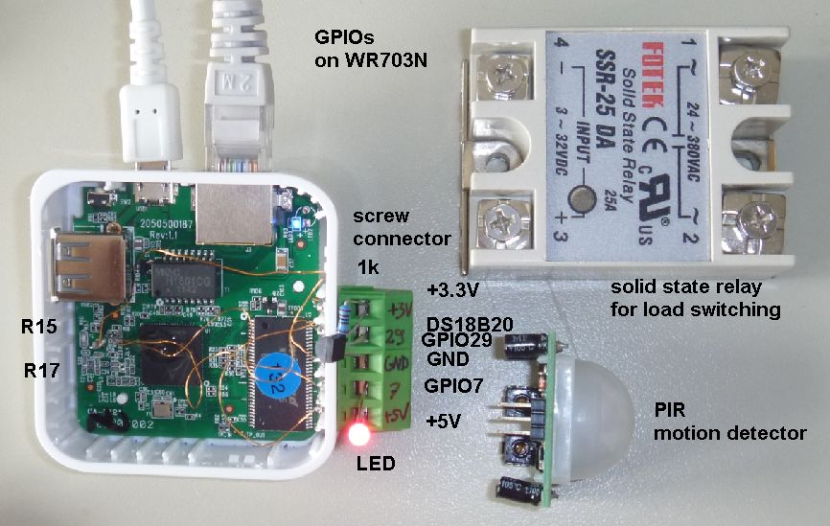
Smart Home Automation

Slide 10
TP-Link WR703N
Low cost (<$25) wireless access point
Small form factor
802.11 b/g/n (Atheros AR9331)
Ethernet port and USB port
400mhz ARM processer (Atheros AR7240)
4mb flash storage
32mb memory

Slide 11
TP-Link WR703N
Keep the small form factor
802.11 b/g/n (Atheros AR9331)
Ethernet port, USB hub
400mhz ARM processer (Atheros AR7240)
8mb flash storage
64mb memory
Serial port
Micro SD Card reader (Removable Storage)
Second Ethernet port

Slide 12

Keep It All Compact

Slide 13
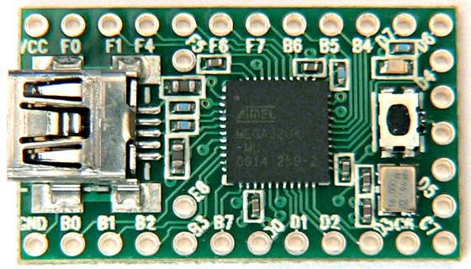
Teensy 2.0

Slide 14
http://wiki.openwrt.org/toh/tp-link/tl-wr703n
USB Hub + USB Storage (https://forum.openwrt.org/viewtopic.php?id=34188)
Serial Port (http://wiki.villagetelco.org/index.php?title=Building_a_Serial_Port_for_TL-WR703N)
Raspberry PI and Teensy
(http://www.irongeek.com/i.php?page=security/raspberry-pi-recipes)

Slide 15
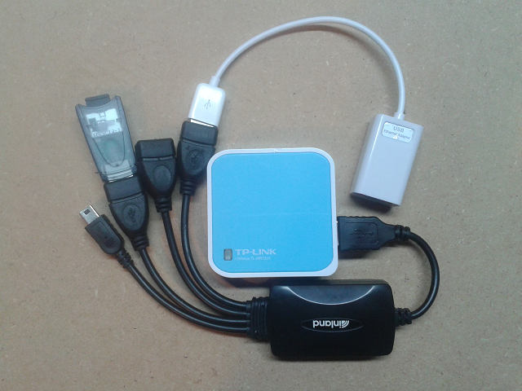
Turn this….

Slide 16
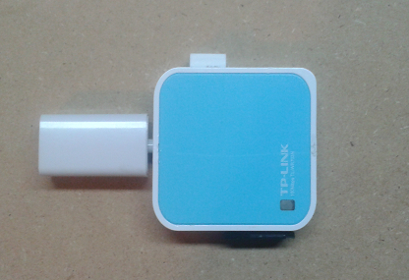
Into this!
Sort of…

Slide 17
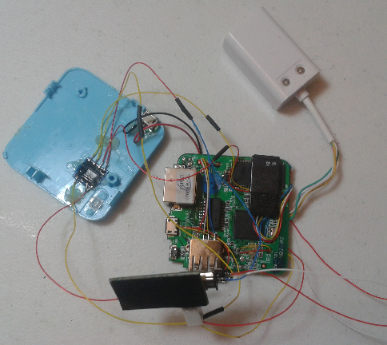
More like this!

Slide 18
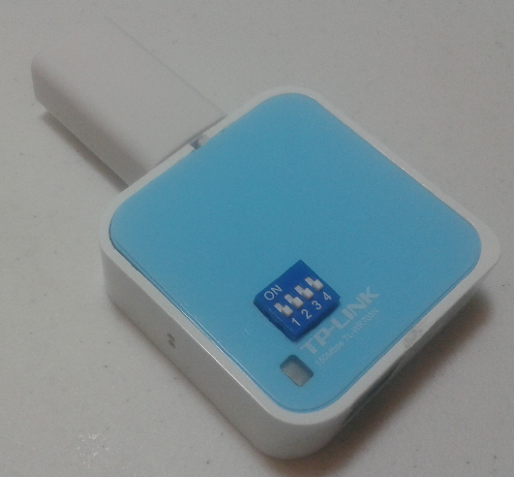
Much better ☺

Slide 19
Upgraded WR703N
Double the memory
  Obtain compatible memory chip, de-solder existing chip, solder new chip
Double the flash (even quadruple it)
  Obtain compatible flash chip, copy existing flash to new chip, de-solder existing flash, solder new chip
  De-soldering and soldering is relatively easy. Flashing the chip is more difficult.

Slide 20
Upgraded WR703N
Seriously, don’t try this at home. Let somebody else do it for you for a small fee. Save yourself the frustration. If you are willing to try make sure you have extra WR703N devices handy because you will break some.
You have been warned.

Slide 21
WR703N (SLBoat Edition)
Ebay user SLBoat sells upgraded WR703N for $40
  Comes with 16mb flash, 8mb chip also provided.
  Ask for only 8mb flash. 16mb flash is buggy and really caused a lot of problems in creating the Super Minipwner
  Comes with 64mb RAM
  http://myworld.ebay.com/slboat

Slide 22
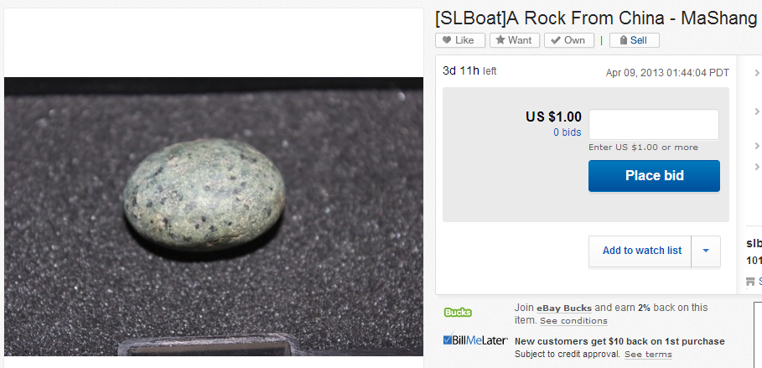
You can also buy a rock from China

Slide 23
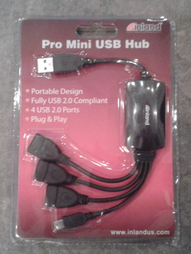
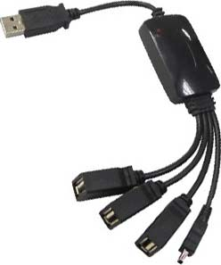
Inland USB Hub
Mfr: Inland | Model: 08818
FRYS.com #6718505 | UPC: 012405088187

Slide 24
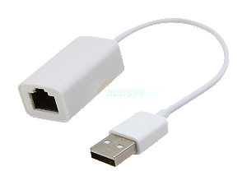
USB to RJ-45 Ethernet Adapter
Mfr: SYBA | Model: SY-ADA24024
newegg.com #N82E16812186164 | UPC: 810154014880

Slide 25
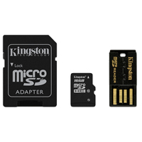
Micro SDHC Flash Media Card with Mobility Kit
Mfr: Kingston | Model: MBLY10G2
microcenter.com #846139 | 740617183009

Slide 26

Sharper Image USB Portable Power Pack Cell Phone Charger

Slide 27
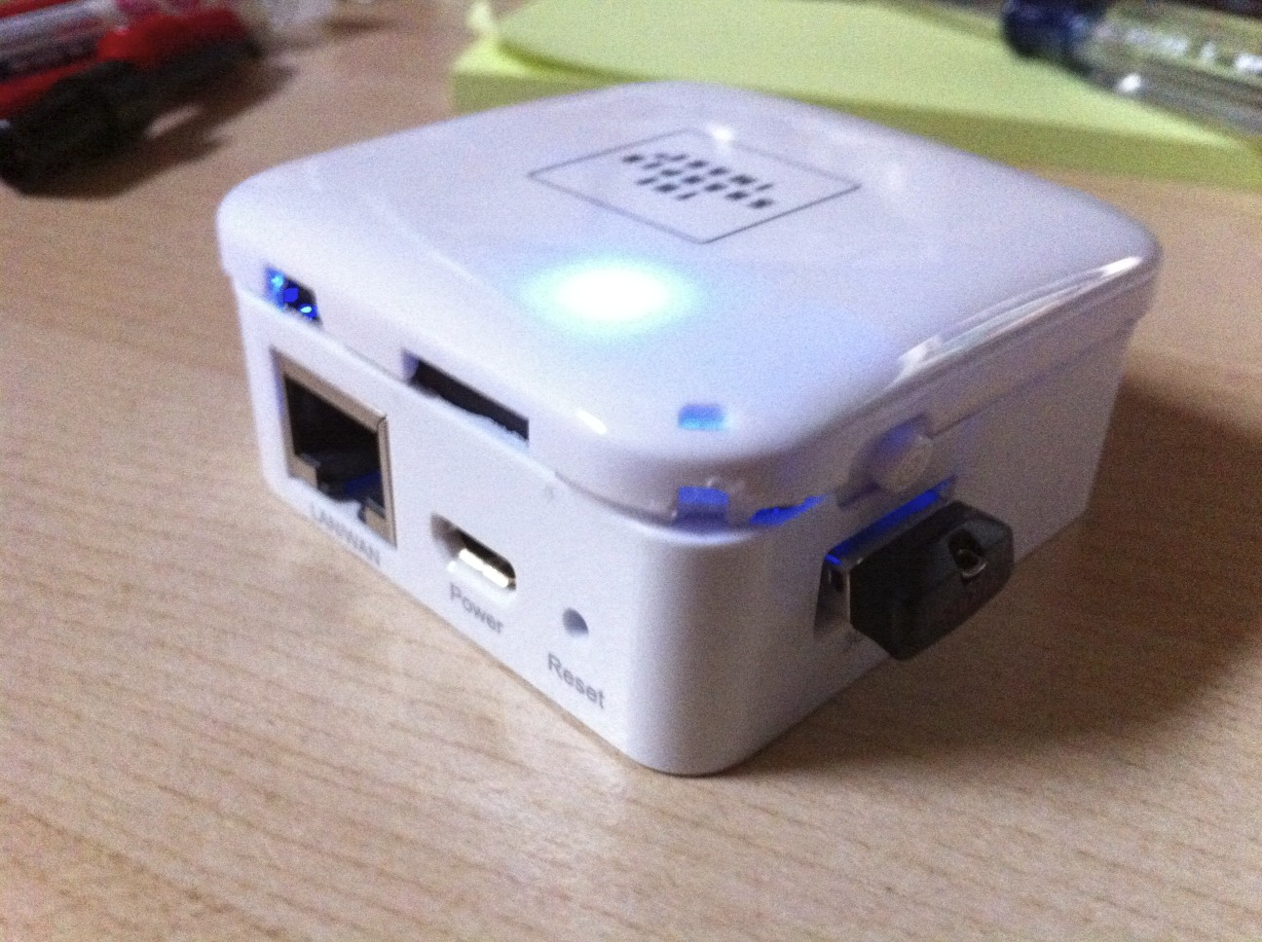
Direct Connect Battery + Use as New Lid

Slide 28
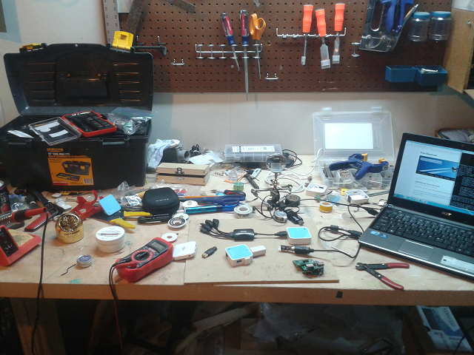
Always Start With a Clean and Organized Workspace

Slide 29
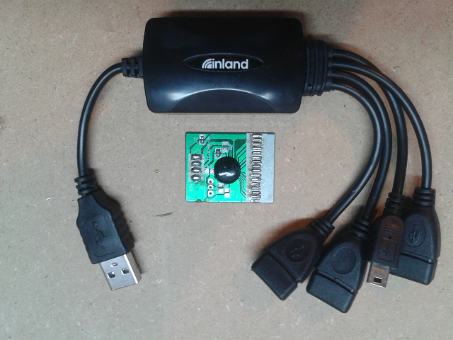
Inland USB Hub

Slide 30
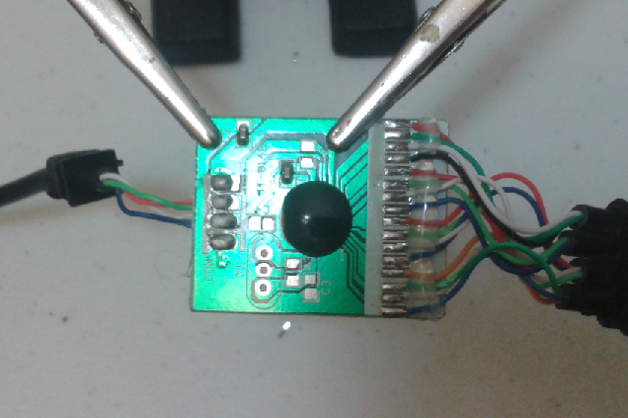
BLUE WIRES! ☺

Slide 31
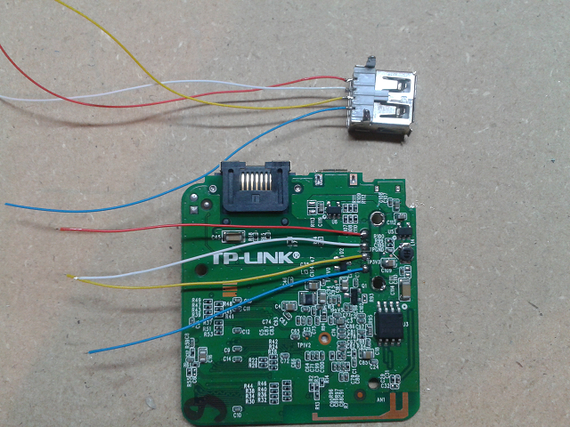
Remove Original USB Connector
Connect USB Hub to the Free USB Port

Slide 32
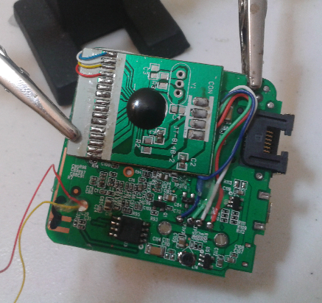
USB hub goes under the main board

Slide 33
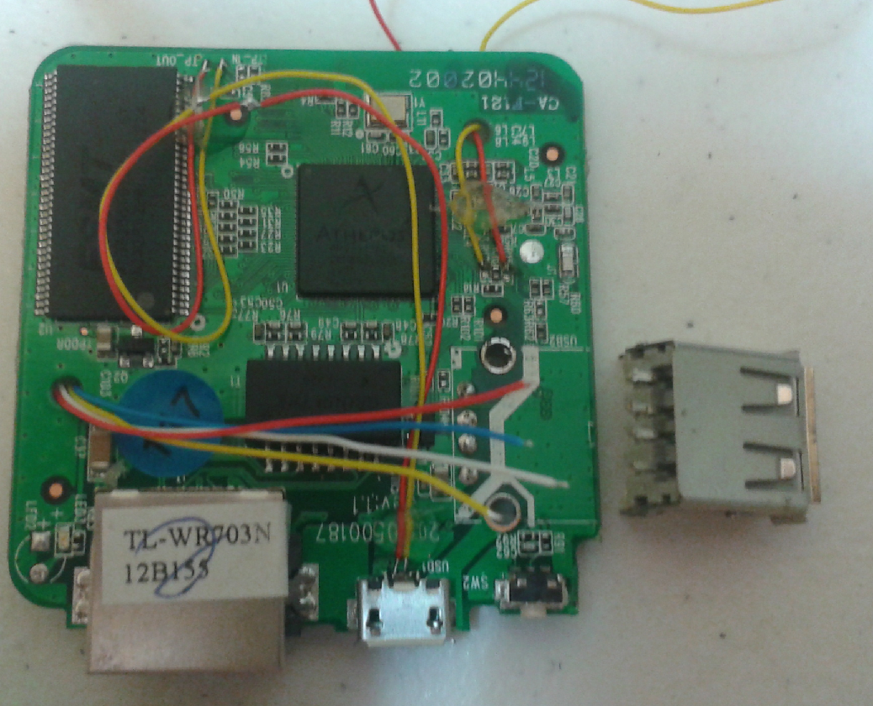
Connect Original Connector to USB hub

Slide 34
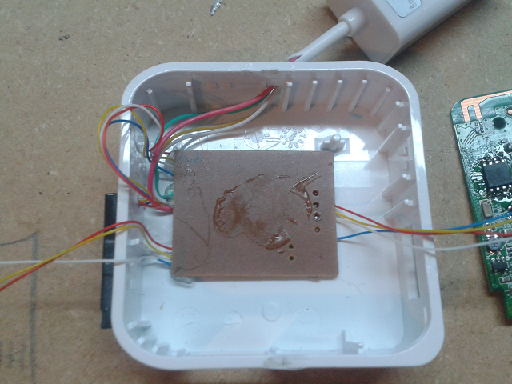
USB hub goes under the main board

Slide 35
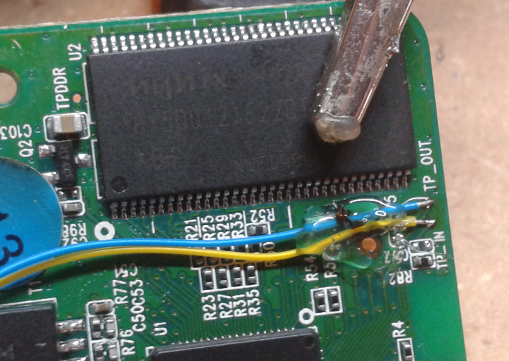
Connect Serial IN/OUT

Slide 36
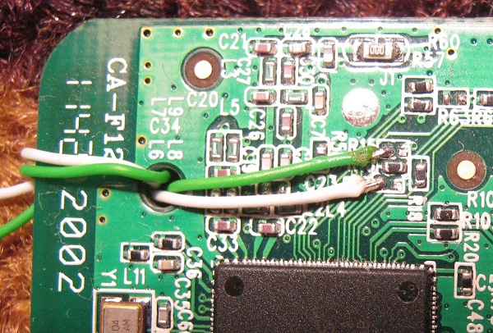
GPIO 7 + 29
I forgot to take a close-up picture of my handiwork.
This image from http://dangerousprototypes.com/2012/07/20/hacking-and-moding-the-tp-link-wr703n-openwrt-wi-fi-router/

Slide 37
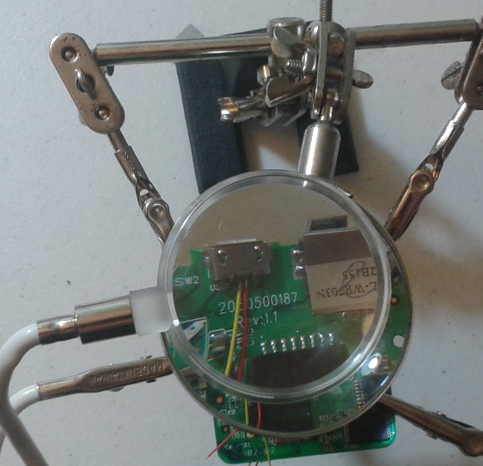
Connect Data+ and Data-

Slide 38
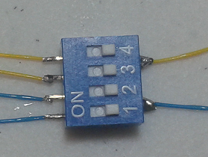
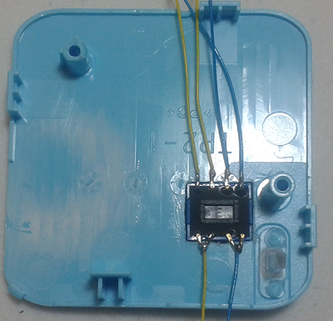
DIP Switch to Choose Serial or GPIO

Slide 39
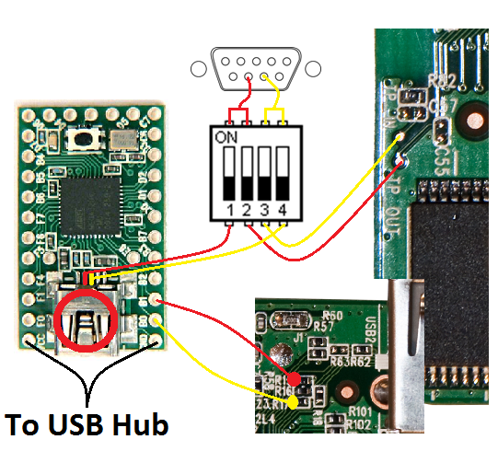
DIP Switch Wiring

Slide 40
Openwrt INIT Script
#!/bin/sh /etc/rc.common
#set GPIO
START=10
start() {
echo start
echo 7 > /sys/class/gpio/export
echo out > /sys/class/gpio/gpio7/direction
echo 0 > /sys/devices/virtual/gpio/gpio7/value
echo 29 > /sys/class/gpio/export
echo out > /sys/class/gpio/gpio29/direction
echo 0 > /sys/devices/virtual/gpio/gpio29/value
}
http://wiki.openwrt.org/doc/techref/initscripts

Slide 41
Turn On/Off GPIO
Turn On
echo 1 > /sys/devices/virtual/gpio/gpio7/value
echo 1 > /sys/devices/virtual/gpio/gpio29/value
Turn Off
echo 0 > /sys/devices/virtual/gpio/gpio7/value
echo 0 > /sys/devices/virtual/gpio/gpio29/value
http://wiki.openwrt.org/doc/techref/initscripts

Slide 42
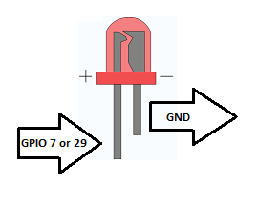
Test It Before Adding TEENSY
Add an LED from R15 (GPIO 7) and R17 (GPIO 29) to ground. When you turn the GPIO on the LED should light up.

Slide 43
TEENSY Code
int b0Pin = 0;
int b1Pin = 1;
void setup() {
pinMode(b0Pin, INPUT);
pinMode(b1Pin, INPUT);
}
if (digitalRead(0)){
}
if (digitalRead(1)){
}

Slide 44
Brought to you by – I’m too busy with my day job to finish my slides!
?

Slide 45
Contact Information
James Edge
james@mainstreamsecurity.com
www.mainstreamsecurity.com

