Slide 1
Information Security is Broken
James Edge

Slide 2
BACKGROUND
Information Security Specialist
CISSP, CISM, CISA, MCSE
15 years Information Technology
12 years Information Security
6 years Information Systems Auditor
10 years Penetration Tester
3 years as a Security Analyst (I’ll never get those years back)

Slide 3
TALK OVERVIEW
Why is Information Security Broken?
What is Broken?
Examples
Research
In the field
Suggested Solutions
Question and Answer
Anti-Virus/IDS/IPS
Patch Management
Password Policies
Privileged Users
Internal Segmentation

Slide 4
AUDIENCE PARTICIPATION
Show of hands
Operations Security?
Penetration Testers?
IS Compliance?
How many here because your professor made you attend?

Slide 5
INFORMATION SECURITY IS BROKEN

Slide 6
INFORMATION SECURITY IS BROKEN
Data Breaches (http://www.riskbasedsecurity.com)
There were 1,837 incidents reported during the first six months of 2016 exposing over 1.1 billion records.
Adobe, Target, JPMorgan Chase, Home Depot, Sony, Anthem, LinkedIn, Yahoo, TJ Maxx

Slide 7
INFORMATION SECURITY IS BROKEN
Sad reality: It's cheaper to get hacked than build strong IT defenses
http://www.theregister.co.uk/2016/09/23/if_your_company_has_terrible_it_security_that_could_be_a_rational_business_decision/
“A study by the RAND Corporation, published in the Journal of Cybersecurity, looked at the frequency and cost of IT security failures in US businesses and found that the cost of a break-in is much lower than thought”

Slide 8
COMPANIES RECOVER

Slide 9
INFORMATION SECURITY IS BROKEN
Anti-Virus/IDS/IPS
Patch Management
Password Policies
Privileged Users

Slide 10
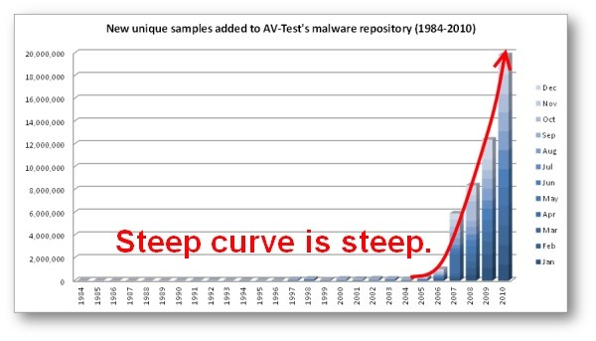
Anti-Virus / IDS / IPS
Signature Based and Reactive
Too many variants makes it difficult to keep up
Malware tested before use
Malware resident in memory
Malware not even needed
powershell
python

Slide 11
PATCH MANAGEMENT
Once patch is released it is reverse engineered
Patch Bundling – better for testing but potential delay if vulnerability actively exploited
0-days exist but most often you don’t even need them.

Slide 12
PATCH MANAGEMENT
How often do you patch? 30 days? 60 days?
What operating systems and software do you patch?
Windows Operating Systems
Third-party software
Adobe Acrobat Reader, Mozilla Firefox, Google Chrome, Adobe Flash
What version of Java are you using?

Slide 13
PATCH MANAGEMENT
NIST Patching Guide (SP800-40r3) http://nvlpubs.nist.gov/nistpubs/SpecialPublications/NIST.SP.800-40r3.pdf
http://www.tenable.com/blog/reducing-your-patch-cycle-to-less-than-5-days-webcast-recording-and-qa
Ideally, an organization would deploy every new patch immediately to minimize the time that systems are vulnerable to the associated software flaws.

Slide 14
PASSWORD SELECTION
Password complexity, minimum length, and expiration policies in place.
☑

Slide 15
PASSWORD POLICIES
Enforce Password Complexity
upper, lower, special character, digit – pick three
Minimum Password Length
8 character? 9? 10?
Password Expiration
30 days - 90 days - 365 days
Do not write your password down

Slide 16
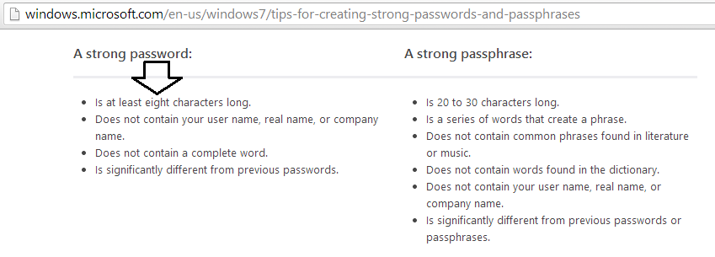
MICROSOFT RECOMMENDATION

Slide 17
ISACA RECOMMENDATION

Slide 18
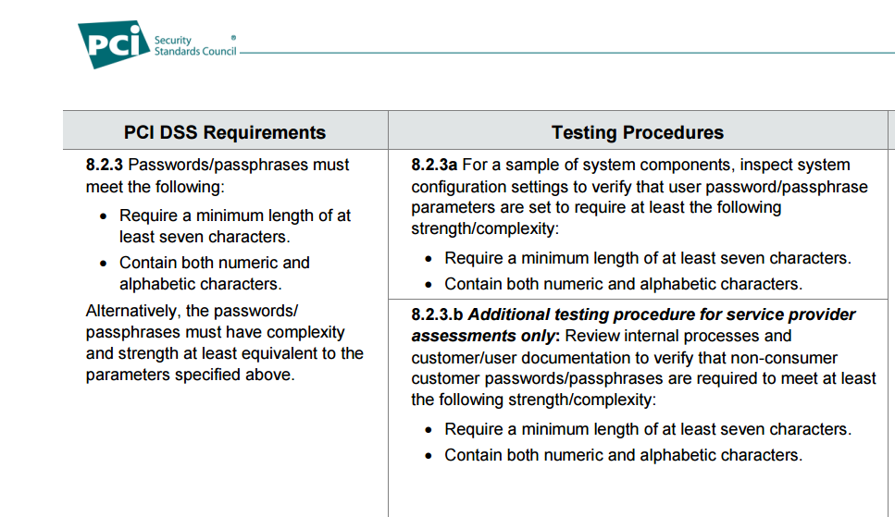
PCI-DSS RECOMMENDATION

Slide 19
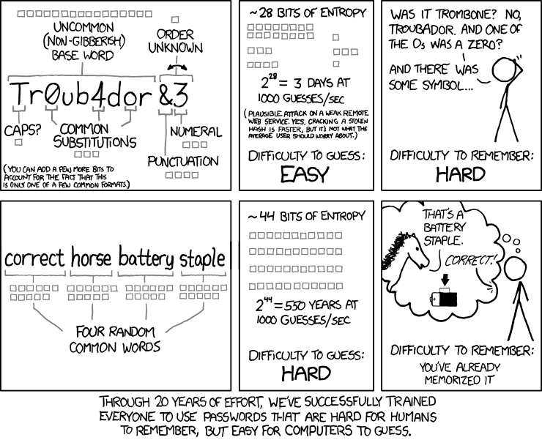
XKCD.COM

Slide 20
XKCD.COM
Through 20 years of effort, we’ve successfully trained everyone to use passwords that are hard for humans to remember but easy for computers to guess.

Slide 21
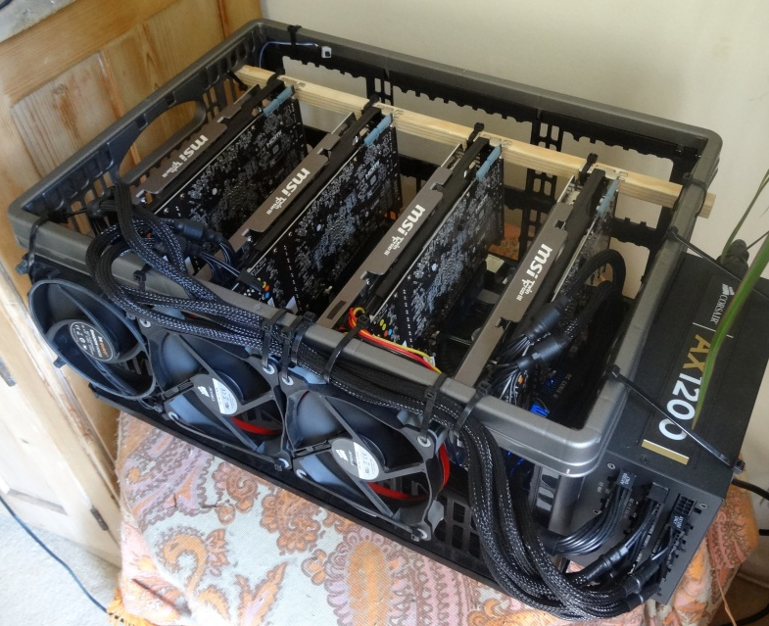
GPU PASSWORD CRACKING
Windows NTLMv2
Hardware
Ubuntu 12.04.3 - 64 bit Catalyst 13.12 - 8x AMD R9 290X - stock core clock
NTLM - 141 Billion guesses a second

Slide 22
GPU PASSWORD CRACKING

Slide 23
PASSWORD MATH
8 character password
Password Complexity
32 Special Characters
10 Digits
26 Lowercase
26 Uppercase
94^8 = 6,095,689,385,410,816 (6 Quadrillion)
94^9 = 572,994,802,228,616,704 (573 Quadrillion)

Slide 24
PASSWORD MATH
8 character password
NTLM
12 hours
9 character NTLM password
47 days
Still plenty of time with a 90 change policy
10 character NTLM password - 12 years

Slide 25
PASSWORD SELECTION
Your passwords are a dictionary word, first letter capitalized, followed by some digits.
Monday66, Monday77, Monday77!
Password1, CompanyName123
90 day expiration
Choose seasons and year
Summer2016, Summer16, Spring16, Spring2016, Winter16
30 day expiration
Choose month and year (September2016)
qwe123TYU%^&9 is not a complex password

Slide 26
PASSWORD SELECTION
Hashcat pattern matching
U L L L L L D D
30.891.577.600 (~31 Billion)
U L L L L L (L or D) (L or D) D D
40.035.484.569.600 (~40 Trillion)
U L L L L L (L or D) (L or D) D (D or S)
164.145.486.735.360 (~164 Trillion)

Slide 27
PASSWORD SELECTION
Real World Results
GeForce GTX 970 Ti, 4096MB, 1664 CUDA Cores
Length 8 - All characters
8 days, 11 hours (9 billion/sec)
U L L L L L D D
3 Seconds
U L L L L L (L or D) (L or D) D D
1 hour 17 minutes
U L L L L L (L or D) (L or D) D (D or S)
5 hours 31 minutes

Slide 28
PRIVILEGED USERS
Regular user is compromised
Phishing attack
Brute force or dictionary attack
Seek elevated privileges and pivot within the environment
Privilege escalation on compromised host
Seek out additional host to compromise
Administrator workstation
Weak local administrator accounts
Capture SAM, system, and Security files
Windows Server 2008/2012 and Workstation 7/8/10
No LM Hash and MSCache v2 hash is computationally strong
Memory capture – offline analysis

Slide 29
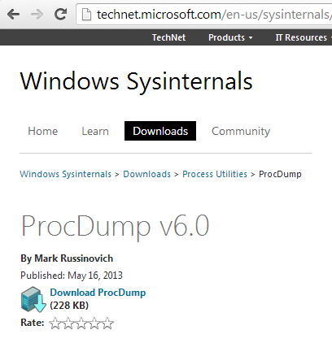
PRIVILEGED USERS
Memory Analysis
ProcDump
Copy over to system you have Local Administrator of SYSTEM level access
Run the command
Copy 40-60mb capture file
Offline analysis to produce plaintext passwords for every account authenticated to the machine

Slide 30
SOLUTIONS
Anti-Virus
You have to have it per a compliance requirement.
Don’t spend an arm and a leg for it

Slide 31
SOLUTIONS
Application Whitelisting
http://nvlpubs.nist.gov/nistpubs/SpecialPublications/NIST.SP.800-167.pdf
Only allow the applications needed for your business

Slide 32
SOLUTIONS
Patch Management
Patch the workstations immediately
Create a test group of semi-knowledgable end users across all business segments
Include all third-party software especially web browers and all software that interacts with the browser (Flash, Silverlight, java, PDF reader, media players)
Know what your users have installed on their workstations

Slide 33
SOLUTIONS
Password Management
Audit user passwords
Capture NetNTLM
Dump local Registry Files (whitelist pwdump)
Audit Active Directory Database NTDS.DIT
Password education
Passphrases
12+ character minimum
Don’t teach substitution
Account lockout of 3 duration of 5 minutes

Slide 34
SOLUTIONS
Privilege Users
Audit the number of privileged user accounts
1 Enterprise Admin
1 Schema Admin
Work with vendors to determine what privileges are needed so there are no Domain Admin accounts for services
Monitor your privileged accounts
Administrators are the first to change their security settings to be less restrictive. Why? Because they can.
Monitor privilege account creation.
Force Administrators to use a less privileged user account for his or her workstation
Ensure they are not using the same password between the two accounts!

Slide 35
SOLUTIONS
You are going to get hacked!
Detect the intrusion
Incident Response
Logging and Monitoring
Security Awareness
Especially C-level. They will be targeted.
If you see something say something.
No repercussions.
The goal is detection before attacker can pivot within the environment, elevate privileges, or access sensitive data.

Slide 36
SOLUTIONS
There is no perimeter
Segment the internal network
Firewall every workstation
One workstation should not be able to communicate with any other workstation over any port.
We don’t live in a peer-to-peer ad-hoc office anymore.
Feel free to let anything out as the attacker will just disable the firewall post compromise.
Monitor specific ports
Don’t let anything in unless from specific servers.
Technical support jump server.

Slide 37
QUESTIONS
James Edge
james.edge@jedge.com
www.jedge.com

