Slide 1
Custom Power Pwn
Atlanta Bsides 2012
James Edge
james.edge@jedge.com
www.jedge.com

Slide 2
The people over at Pwnie Express are coming out with a neat device called the Power Pwn. This device follows up on the Pwn Plug and the PwnPhone. With my experience as a penetration tester and junior hardware hacker I’ve been working on my own “pwn” hardware. I combined the PCEngines Alix 6f2, an APC BE650R Battery Backup Power Strip, and a battery Power Pack for a Custom Power Pwn. I integrated the Alix connectors for the serial, ethernet, and external antenna connectors with the existing APC coax, rj45, and rj50 ports. This talk is a show and tell on what I did and how anyone who is a fan of hardware hacking can do this themselves.

Slide 3
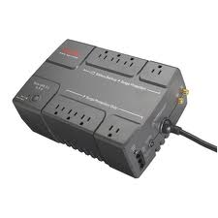
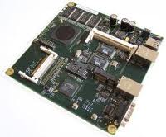

Custom Power Pwn
+
+
x86 special purpose network board
Power Pack
Used UPS

Slide 4
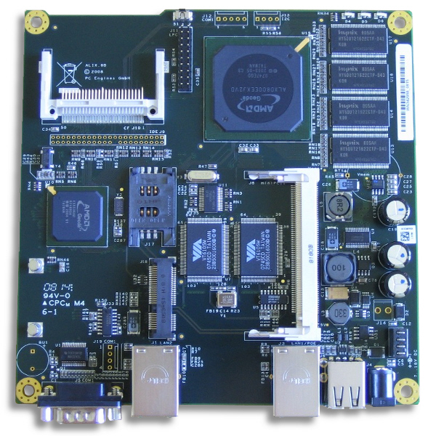
Alix 6f2 Board
ALIX.6F2 system board
500 MHz AMD Geode LX800
256 MB
2 LAN
1 miniPCI
1 miniPCI Express
2 USB
dual SIM sockets
Compact Flash and 44pin IDE
Serial Port
RTC Battery

Slide 5

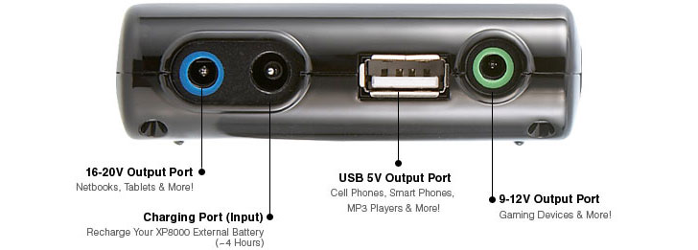
Energizer XP8000A (xpal)
Specifications
Battery Cell: Lithium Polymer
Power Capacity: 8000 mAh
Rated Input: DC 19V, Max 3500 mA
Rated Output:
DC 5V, 2100mA
DC 12V, 2000mA
DC 19V, 2000mA
Recharge Time: ~4 Hrs
Weight: 0.5 lbs / 0.22 kg
Dimensions: 4.3(L) x 2.9(W) x 0.9(H) inches
11(L) x 7.3(W) x 2.3(H) cm
Excellent Review of External Power Packs
http://www.tomshardware.com/reviews/notebook-battery-external-power-supply,2821.html

Slide 6
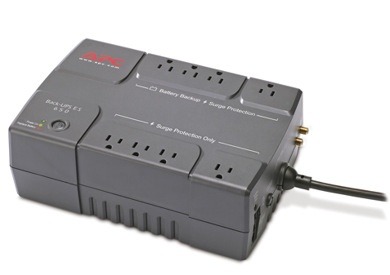
APC UPS - BE650R
Analog phone line for phone/fax/modem/DSL (RJ-45 connector), Network line - 10/100 Base-T Ethernet (RJ-45 connector), Coaxial cable for CATV/SATV/modem/Audio-Video (coax connector)

Slide 7
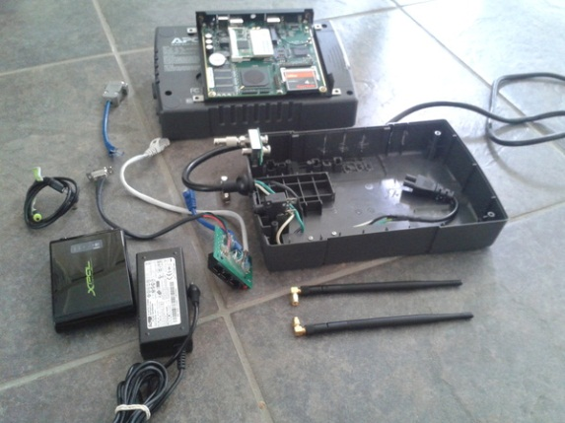
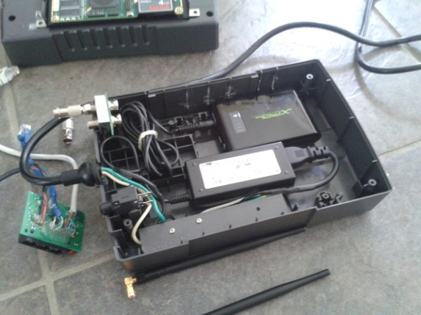
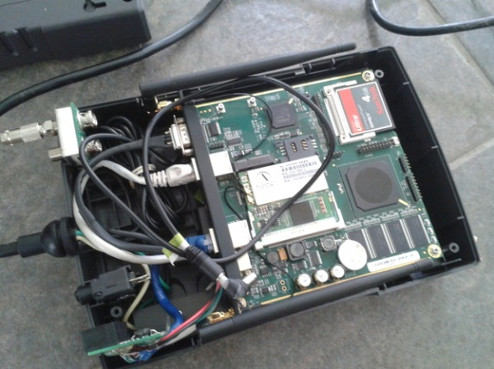
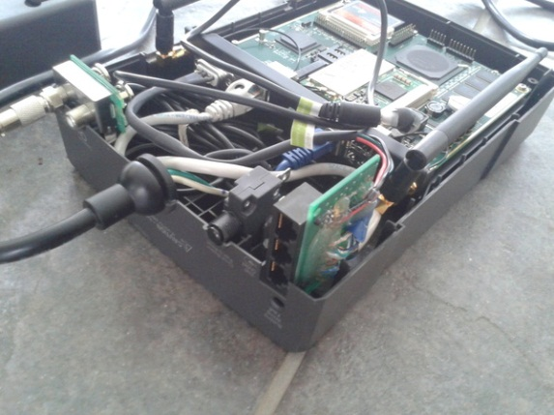
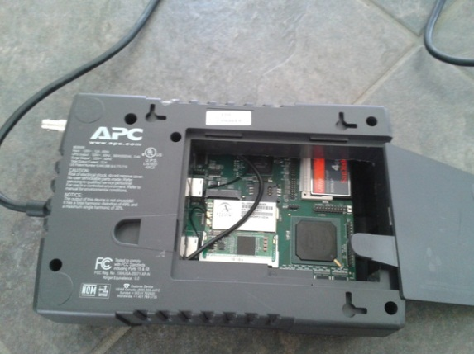
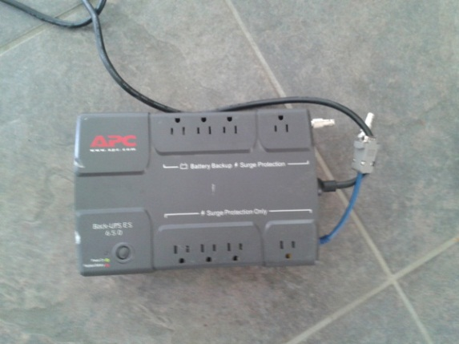
Custom Power Pwn

Slide 8
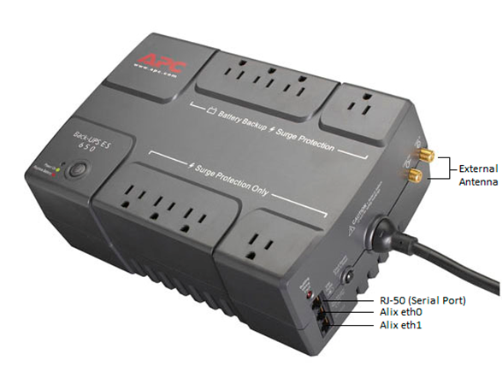
APC External Connections

Slide 9
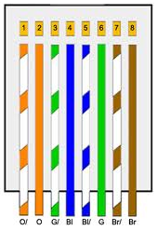
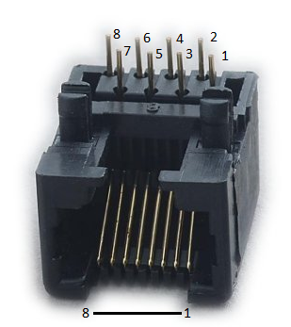
APC RJ45 Ethernet Ports
The APC offers surge protection for Ethernet connections . There exists a DSL/Modem/Network/Fax Port (data in) and a Data Port (data out). I took a cat5e patch cable and cut it in half soldering the wires of the two pieces to the back of the circuit board RJ45 sockets. The pictures below show the pin numbers from the view of the back of the circuit board and the corresponding wire colors you would solder to the pins.
RJ45 PCB Pinout

Slide 10
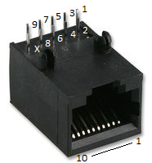
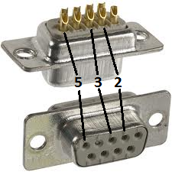
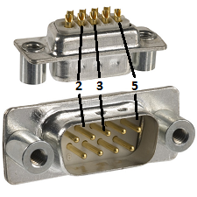
APC RJ50 for Serial Port Access
The APC offers an RJ50 (10 pin) console port for computer management in case of a power outage. A USB to RJ50 adapter is used for this purpose however we will utilize a plain RJ45 plug because it works and we only need access to three wires for proper serial communication to the Alix 6f2. We are making a custom adapter since there is no room in the APC for an off the shelf adapter. It doesn’t matter how you wire it as long as it is a straight through connection for the three wires (RX, TX, GND) from the Alix serial port to the end that will connect to the laptop.
I connect the RJ50 pins 3, 5, & 7 to the DB9 Female plug pins 3 (TX), 2 (RX), & 5 (GND)
RJ50
DB9 Female
The RJ45 Cat5e connector pins 2, 4, & 6 (Orange, Blue, & Green) match up to pins 3, 5, & 7 on the 10 pin RJ50 plug.
I connect the RJ45 Cat5e connector pins 2, 4, & 6 (Orange, Blue, & Green) to the DB9 Male plug pins 2 (RX), 3 (TX), & 5 (GND)

Slide 11
Additional Hardware
Mini-PCI Wireless Card
mPCI-Express GSM WWAN modem
Pigtail Cables
  U.FL or MMCX to RP-SMA pigtails
  F Plug to RP-SMA Jack (male pin)RF pigtail
  F female nut bulkhead to RP-SMA male pigtail
DB9F-DB9F null modem
  Serial to USB adapter
Compact Flash card
  Optional 44pin IDE 2.5” drive
External 802.11 and GSM antennas
Cat 5e Flat Ethernet Cable

Slide 12
Additional Hardware
Mini-PCI Wireless Card
  Atheros AR5213A, AR5212, or AR5414
    Support for monitor mode and packet injection
    http://store.netgate.com/miniPCI-Cards-C26.aspx
    Ebay: Atheros AR5213A AR5004G - $5
    For name brand go with Ubiquiti and Alfa
GSM WWAN Card
  Sierra Wireless MC8775
NOTE: Pay attention to the connectors on the cards. You will see U.FL or MMCX and will need to correct pigtail.

Slide 13
The Operating System
The PCEngines.sh Alix page lists a plethora of operating systems that run on the Alix. This is because the Alix is based on the x86 architecture.
Operating systems include various flavors of Linux, BSD, as well as Microsoft Windows.
This project used the Debian-for-Alix OS. This is a custom image specifically for Alix devices.

Slide 14
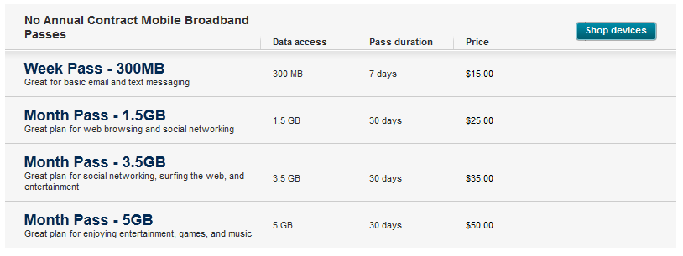
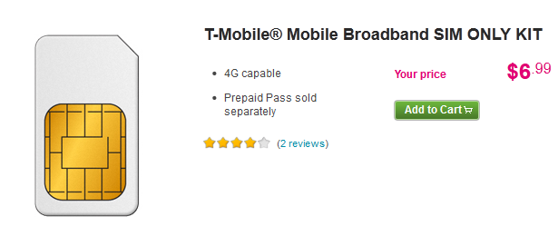
Prepaid Cellular (T-Mobile)
http://www.t-mobile.com/shop/plans/Cell-Phone-Plans.aspx?catgroup=MobileBroadband&WT.z_shop_plansLP=Mobile_broadband

Slide 15
Custom Power Pwn - Links
http://www.energizerpowerpacks.com/us/products/xp8000a/index.html
http://pcengines.ch/
http://store.netgate.com/
http://www.apc.com/resource/include/techspec_index.cfm?base_sku=BE650R
http://www.ebay.com/sch/i.html?_nkw=MC8775
http://code.google.com/p/debian-for-alix/
http://www.jedge.com/wordpress/2012/08/my-custom-power-pwn/

Slide 16

Inspiration brought to me by …
Pwnie Express
  http://pwnieexpress.com/products/power-pwn

