Slide 1
Back to the Future with Information Security How Embedded Devices Have Turned Back the Security Clock
James Edge
Information Security Specialist

Slide 2
Who Am I?
Penetration Tester with Experis US, Inc.
Internal, external, wireless, physical security, social engineering, and web applications.
Former Security Analyst with CBTS at GE Energy
Information Systems Auditor for the state of Georgia and New York
Conducted Information Systems audit of KSU in 2008

Slide 3
Agenda
Overview of Embedded Devices
State of Embedded Device Security
Embedded Devices in the News
SOHO Devices
Demonstrations
Firmware Analysis
Authentication Bypass 0-day
Default Credentials and the Internet
Questions

Slide 4
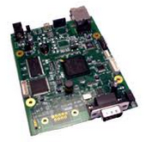
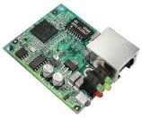
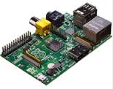
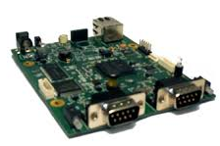
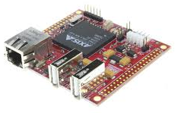
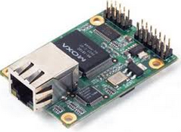
What is an Embedded Device?
An embedded device is an object that contains a special-purpose computing system. The system, which is completely enclosed by the object, may or may not be able to connect to the Internet. Embedded systems have extensive applications in consumer, commercial, automotive, industrial and healthcare markets.
http://whatis.techtarget.com/definition/embedded-device

Slide 5
http://ayehu.com/how-the-internet-of-things-will-complicate-incident-response/

Slide 6
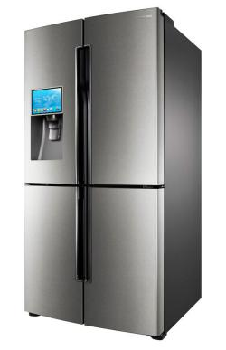
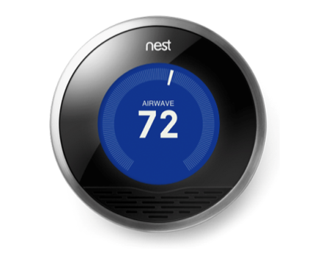
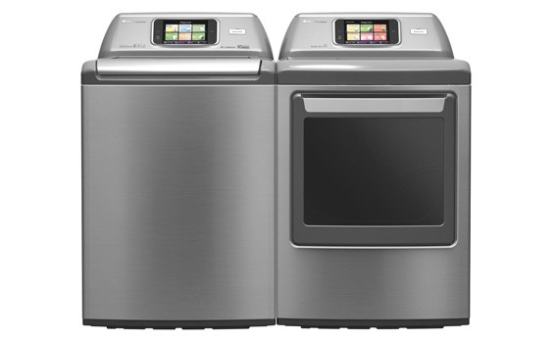
The Internet of Things
The Internet of Things (IoT) is the network of physical objects or "things" embedded with electronics, software, sensors, and network connectivity, which enables these objects to collect and exchange data.
https://en.wikipedia.org/wiki/Internet_of_Things

Slide 7
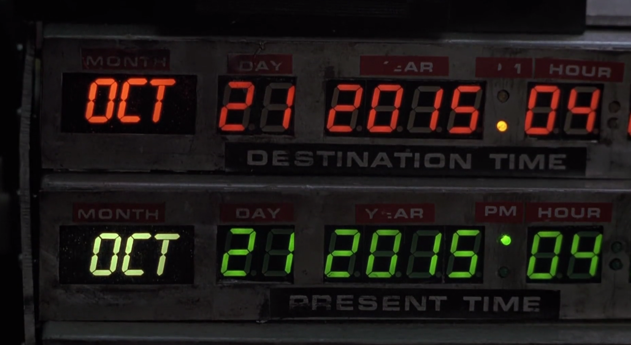
Back to the Future with Information Security

Slide 8
Back to the Future with Information Security

Slide 9
Back to the Future with Information Security

Slide 10
Back to the Future with Information Security
Lets hop in our Delorean and head back in time where systems were developed without considering
security.
The current state of
embedded device security
is reminiscent to PC computing
20 years ago.
It may not be 1985 but a 1995 mentality
on security for devices connected to the Internet is scary.
Scarier than Jaws 19
http://shop.lego.com/en-US/The-DeLorean-time-machine-21103

Slide 11
Back to the Future with Information Security

Slide 12
Back to the Future with Information Security
“It's not unlike what happened in the mid-1990s, when the insecurity of personal computers was reaching crisis levels. But this time the problem is much worse, because the world is different: All of these devices are connected to the Internet.”
-Bruce Schneier
https://www.schneier.com/blog/archives/2014/01/security_risks_9.html

Slide 13
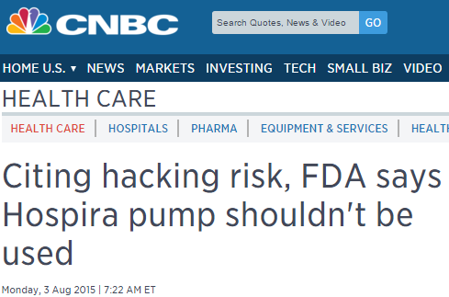
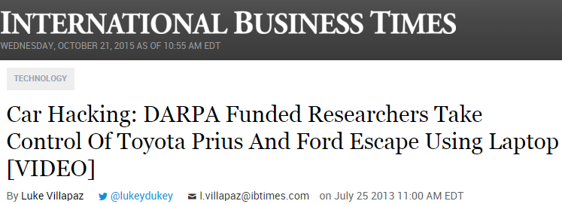
Embedded Security in the News

Slide 14
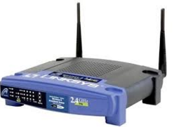
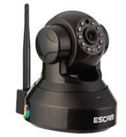
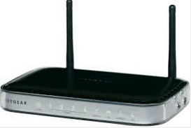
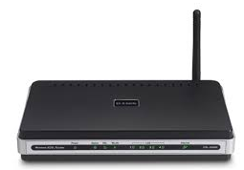
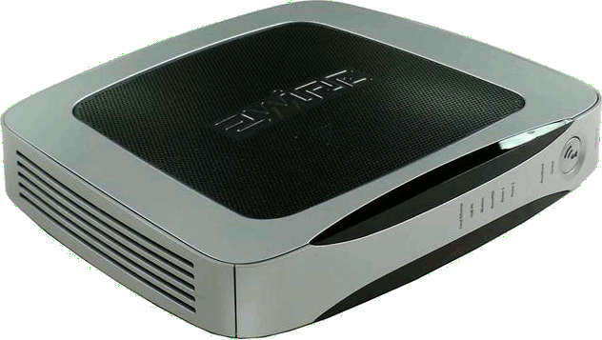
Small Office / Home Office (SOHO) Devices
Wireless Access Points
Routers
DSL/Cable Modems
Security Cameras
VPN Appliances
https://en.wikipedia.org/wiki/Internet_of_Things

Slide 15
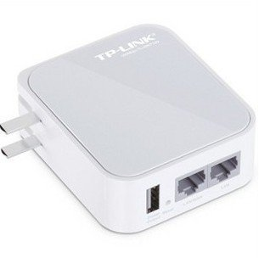
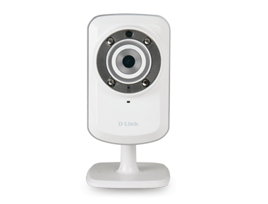
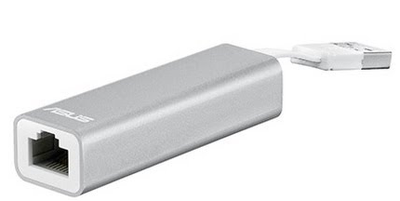
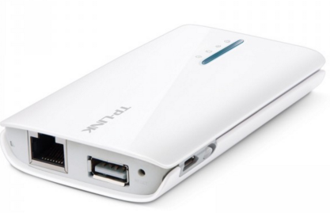
Small Office / Home Office (SOHO) Devices
Run outdated versions of Linux
Run outdated Open Source software
Samba Network File System
OpenSSL
Contain binary blobs for drivers or the entire firmware
Embedded Web Services
Allegro Rompager
GoAhead

Slide 16
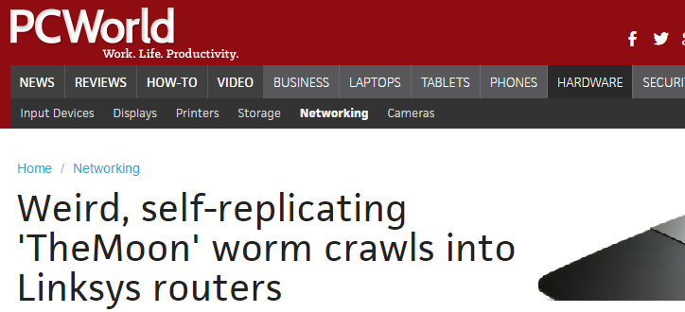
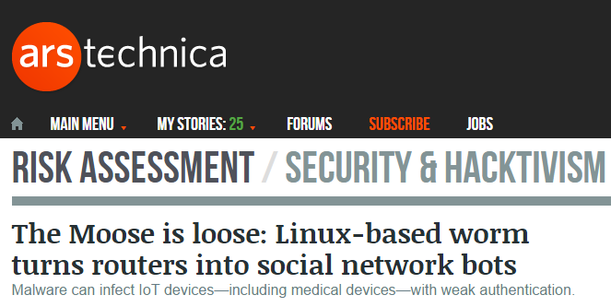
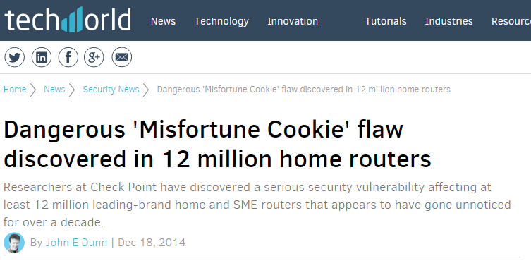
SOHO Embedded Security in the News

Slide 17
The Current State of SOHO Embedded Security

Slide 18
The Current State of Embedded Security

Slide 19
Back to the Future with Information Security
Authentication Bypass
Default or Embedded Passwords
Directory Traversal
Cross-site Request Forgery (CSRF)
Command Injection
Code Execution
Cross-site Scripting (XSS)
https://en.wikipedia.org/wiki/Internet_of_Things

Slide 20
Demonstration

Slide 21
Toolkit
Web Browser (Firefox)
Firebug Plugin
Proxy (Burp Suite)
Firmware Analysis Tool (Binwalk)
Device (DIR-130)
Device firmware (ver. 1.23)
http://www.support.dlink.com/ProductInfo.aspx?m=DIR-130
https://en.wikipedia.org/wiki/Internet_of_Things

Slide 22
Demonstration – D-Link DIR-130

Slide 23
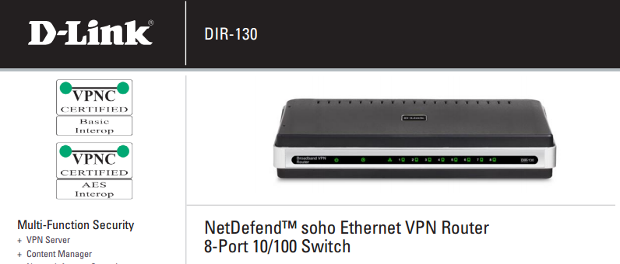
D-Link DIR-130
https://en.wikipedia.org/wiki/Internet_of_Things

Slide 24
D-Link DIR-130
https://en.wikipedia.org/wiki/Internet_of_Things

Slide 25
Steps for Vulnerability Discovery
Enumeration during a penetration test discovered a D-Link DIR-130 externally accessible.
Research into D-Link identified work by Craig Heffner at http://www.devttys0.com/blog/
Downloaded firmware from D-Link Support
Extracted file system using Craig’s tool Binwalk
Identified the web application files
Using Burp Suite and the Firefox Web Browser I conducted manual testing
Discovered the authentication bypass vulnerability

Slide 26
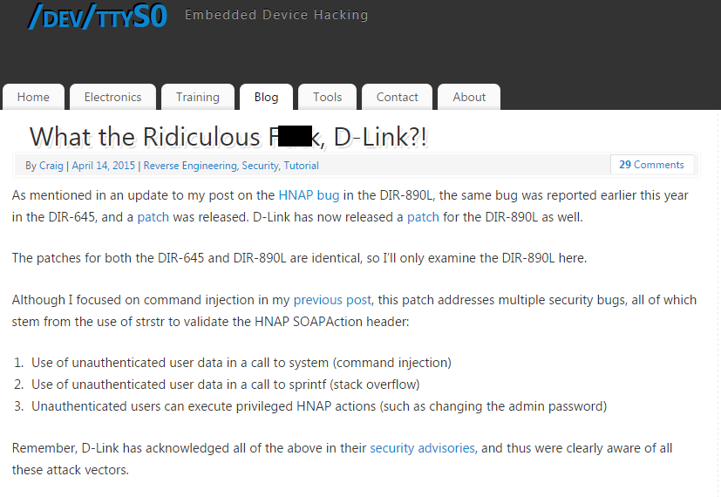

Slide 27
Shodan.io
“Content-length: 65” “200 OK” -Server
https://en.wikipedia.org/wiki/Internet_of_Things

Slide 28
Demonstration – ESCAM

Slide 29
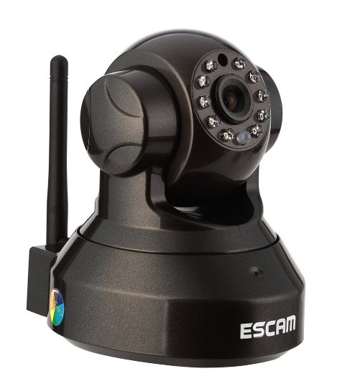
ESCAM Pearl

Slide 30
Shodan.io
401 Unauthorized port:”81” country:”CN”

Slide 31
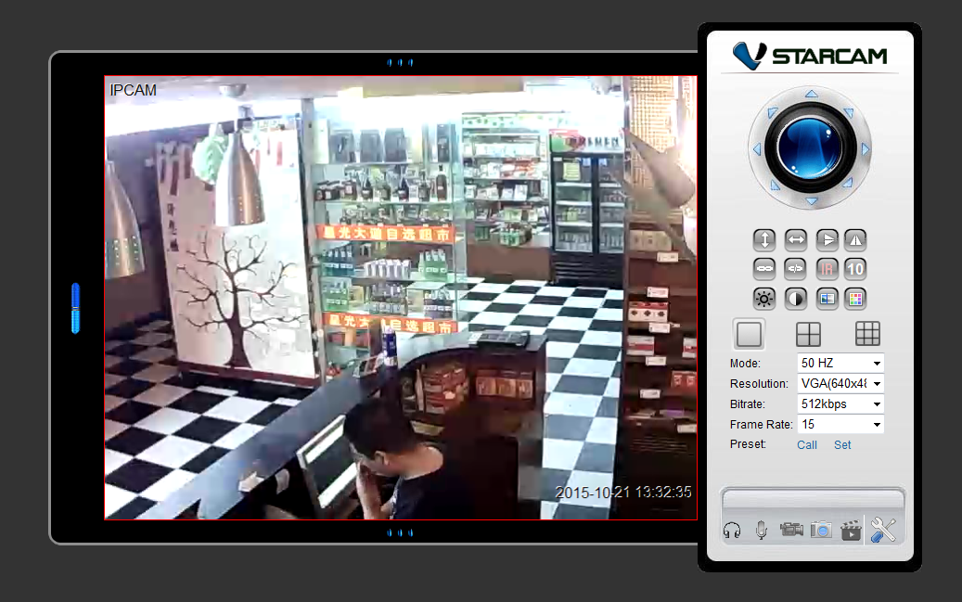

Slide 32
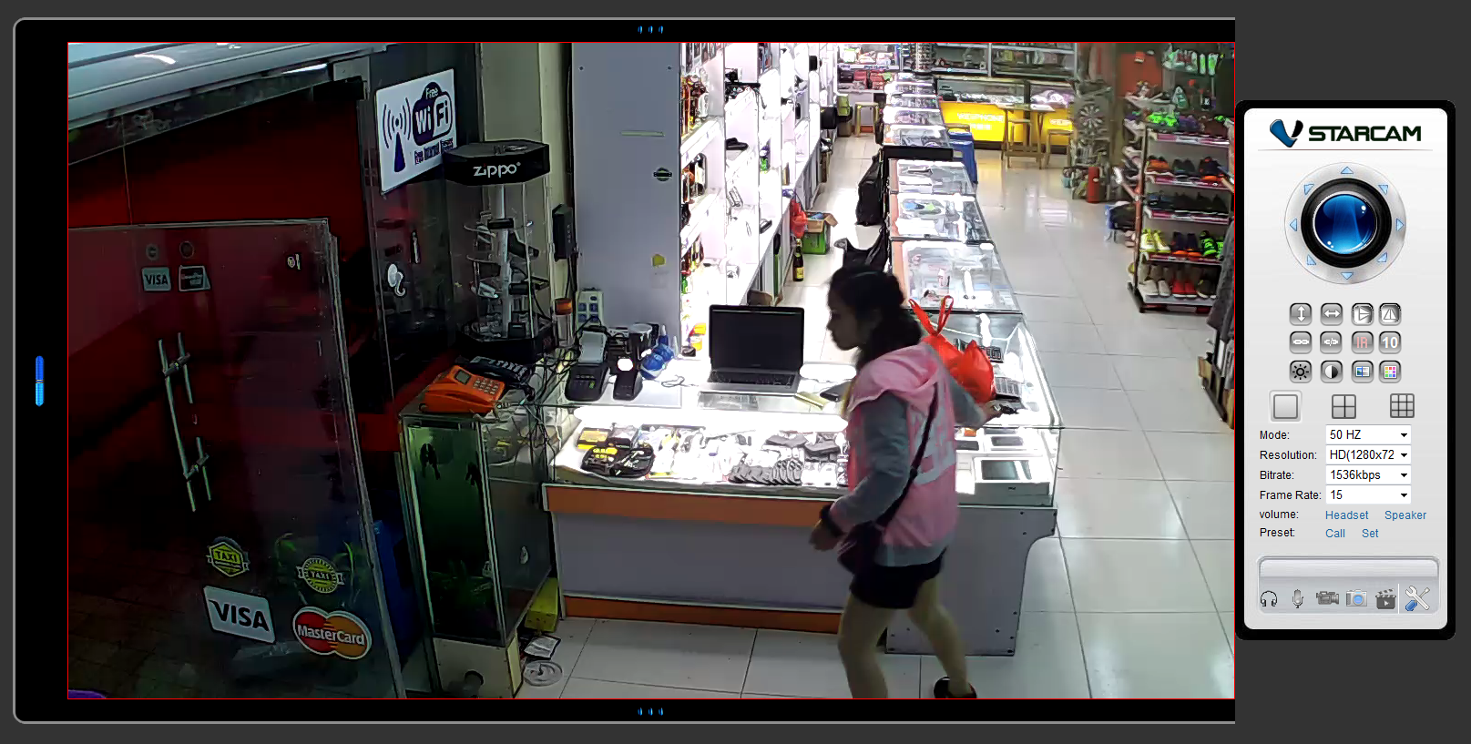

Slide 33
James Edge
Information Security Specialist
Information Security Center of Expertise
Experis US, Inc
James.Edge1@experis.com

